Slide 1




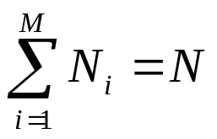
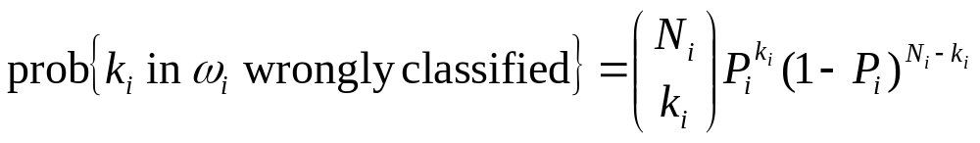
SYSTEM EVALUATION
The goal is to estimate the error probability of the designed classification system
Error Counting Technique
  Let classes
  Let data points in class for testing.
  the number of
  test points.
  Let P_{i} the probability error for class ω_{i}
  The classifier is assumed to have been designed using another independent data set
  Assuming that the feature vectors in the test data set are independent, the probability of k_{i} vectors from ω_{i} being in error is

Slide 2
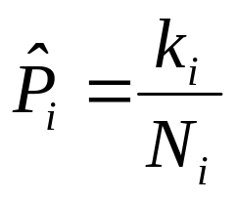
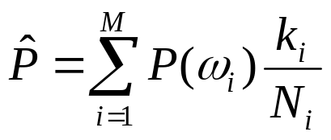
  Since P_{i}’s are not known, estimate P_{i} by maximizing the above binomial distribution. It turns out that
  Thus, count the errors and divide by the total number of test points in class
  Total probability of error

Slide 3

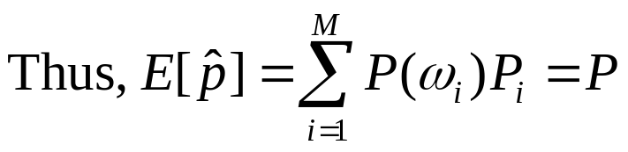
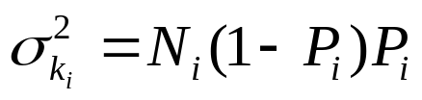
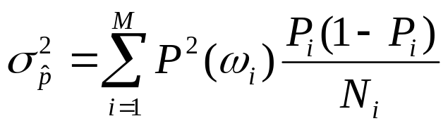
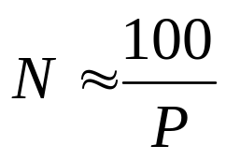
  Statistical Properties
  Thus the estimator is unbiased but only asymptotically consistent. Hence for small N, may not be reliable
  A theoretically derived estimate of a sufficient number N of the test data set is

Slide 4

Exploiting the finite size of the data set.
  Resubstitution method:
  Use the same data for training and testing. It underestimates the error. The estimate improves for large N and large ratios.
  Holdout Method: Given N divide it into:
  N₁: training points
  N₂: test points
  N=N₁+N₂
    Problem: Less data both for training and test

Slide 5
  Leave-one-out Method
  The steps:
    Choose one sample out of the N. Train the classifier using the remaining N-1 samples. Test the classifier using the selected sample. Count an error if it is misclassified.
    Repeat the above by excluding a different sample each time.
    Compute the error probability by averaging the counted errors

Slide 6
  Advantages:
    Use all data for testing and training
    Assures independence between test and training samples
  Disadvantages:
    Complexity in computations high
  Variants of it exclude k>1 points each time, to reduce complexity

